Slide 1

QuizzHubb
- A Quiz Website
Presentation by: University Name:
Aman jain gla University
(2115000127)
Bhav agarwal dept. name: computer
(2115000290)
Rishabh Tiwari engineering & Applications
(2115000847)
date: 1-12-23

Slide 2


Introduction
Quiz Website is a dynamic and user-friendly platform designed for individuals to effortlessly share their life experiences, innovative ideas, and profound thoughts.
The platform is built using the technology, which includes HTML, CSS, JS, and Firebase(Realtime DataBase).

Slide 3

Audience Expectation
🧠 Diverse Content: Explore a wide range of quiz topics, covering various subjects and interests to cater to different users.
🚀 User-Friendly Experience: Enjoy an intuitive and easy-to-navigate platform for both quiz takers and creators, ensuring a seamless experience.
🌍 Global Community: Connect with a diverse and global community of quiz enthusiasts, fostering a sense of camaraderie and competition on a worldwide scale.
📸 Multimedia Rich: Immerse yourself in quizzes enhanced with multimedia elements such as images, videos, and interactive features for a more engaging experience.
📆 Regular Updates: Stay informed and entertained with a constant stream of fresh and updated quizzes, keeping the content dynamic and relevant.
🌱 Growth Opportunities: Provide a platform for both experienced and new quiz creators to thrive, fostering a community where knowledge-sharing and learning are encouraged.

Slide 4

Objectives
. . Facilitate Quiz Creation
. Boost Engagement
. Drive Social Media Growth
. Prioritize User Experience
. Enable Global Reach
Aim
. Foster a Dynamic Platform for Global Connection: Create an interactive space that transcends borders, allowing individuals from across the globe to connect, collaborate, and share diverse insights.
. Empower Individuals to Share Distinctive Narratives: Offer a stage where users can express and exchange their unique experiences and perspectives, promoting a rich tapestry of stories from different corners of the world.

Slide 5

Problem Statement
The challenge at hand is the absence of an intuitive and dynamic platform that enables individuals to effortlessly capture and share their unique life experiences, ideas, and reflections. “quizzhubb" aims to address this gap by offering a user-friendly space for content creation and publication, emphasizing audience engagement, fostering social media growth, and ensuring an enriching user experience through thoughtful design strategies.
" quizzhubb " holds significance as it empowers individuals to amplify their narratives, ideas, and experiences on a global scale, nurturing a vibrant and inclusive online community. It facilitates the exchange of knowledge, encourages active user participation, and provides valuable educational opportunities, contributing to the development of a dynamic and welcoming online environment.

Slide 6

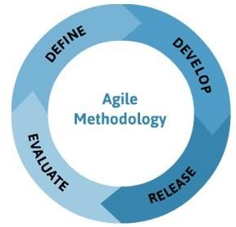
Methodology
. The methodology used in this project include repetition of design, code and implementation then testing and analyzing the result. Further when repeating the phases again, new functionalities are added to the project. This methodology is called agile methodology.

Slide 7

Tools & Languages
Web Development Languages:
HTML/CSS - Fundamental languages for structuring and styling web pages.
JavaScript - Essential for adding interactivity and dynamic features to the website.
Database Management:
Firebase- A relational database management system.
Content Creation and Editing:
Tools like Microsoft Word and Google Docs.
Grammarly for improving written content quality.

Slide 8
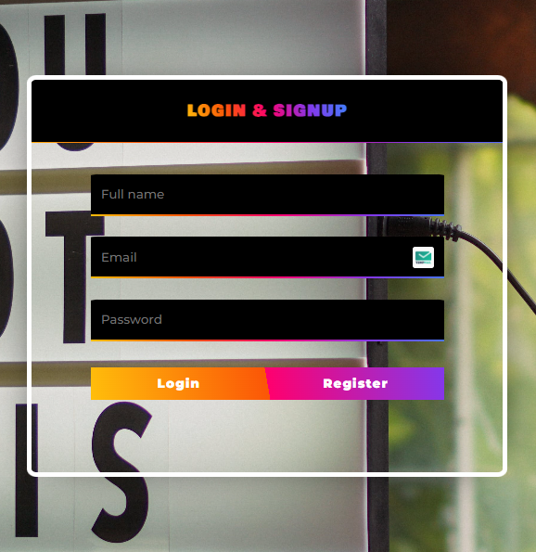
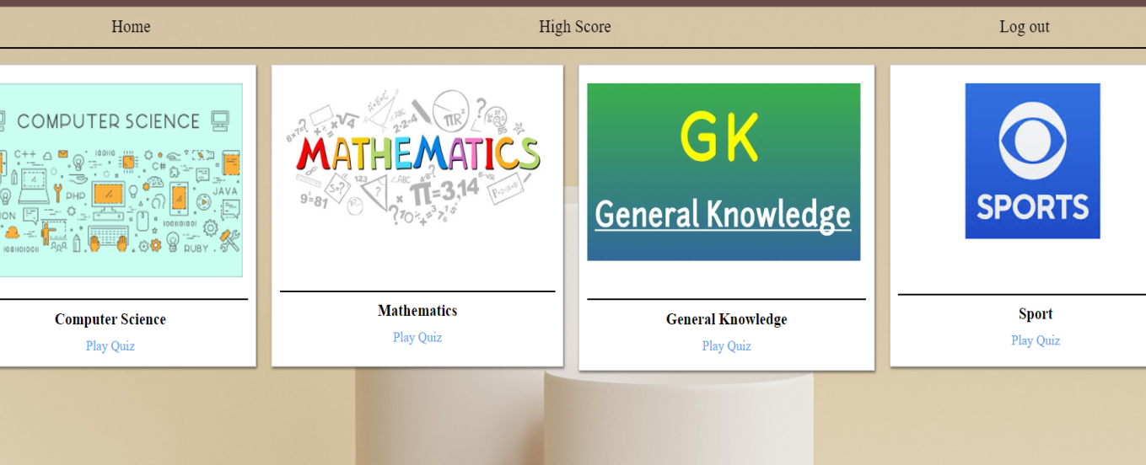
Implementation
Login & Sign Up Page:
Home Page

Slide 9
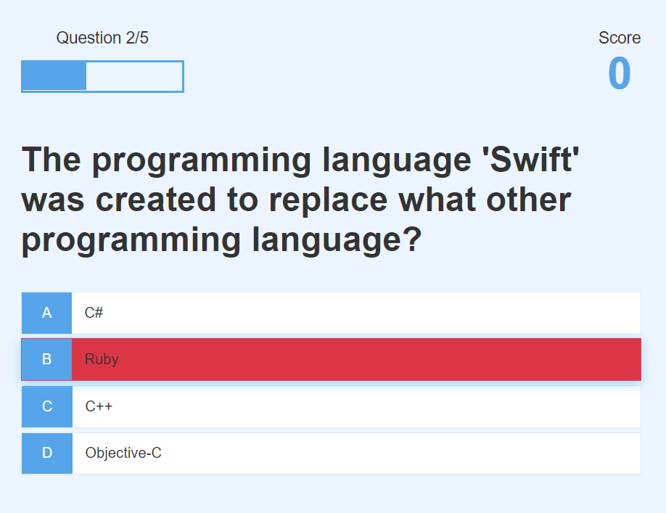
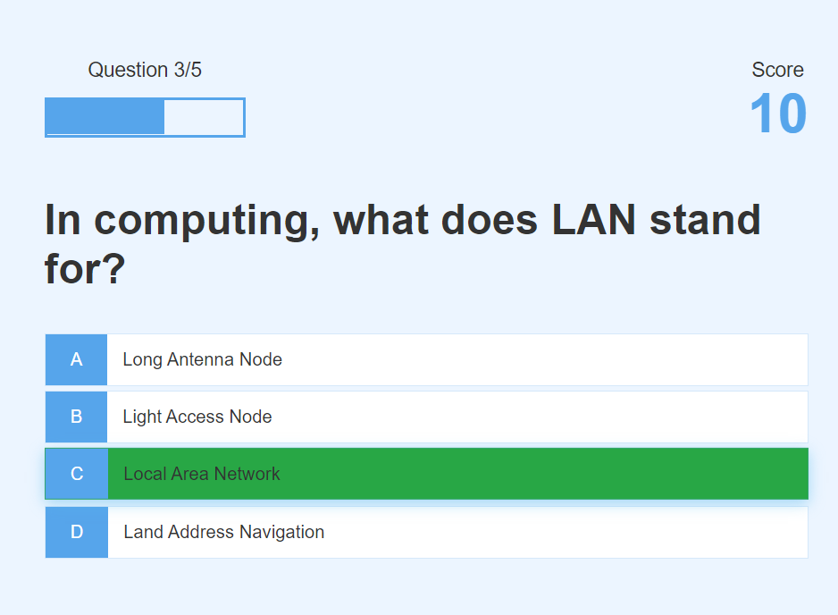
Playing Quiz

Slide 10
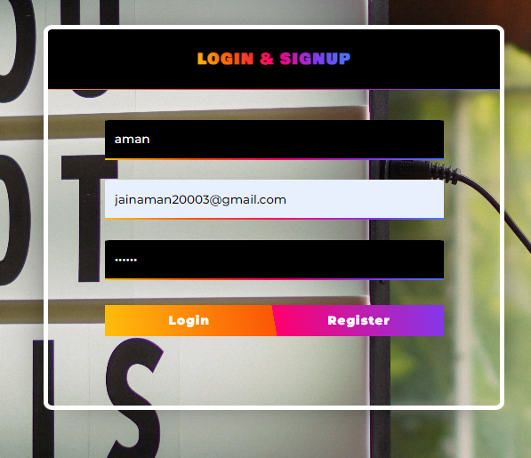
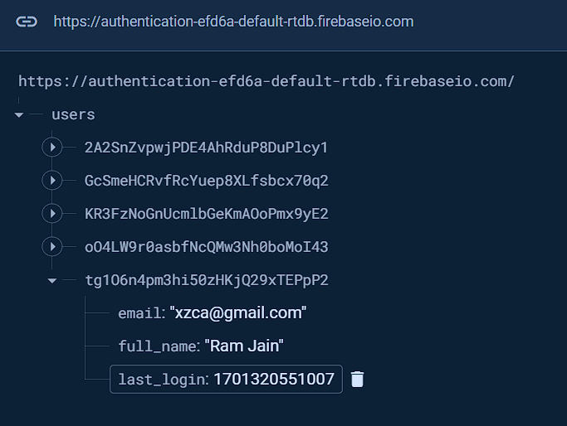
CHALLENGES FACED
Sign Up Problem:

Slide 11
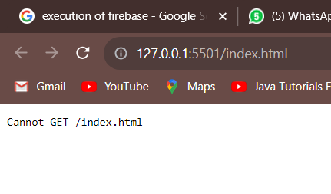
Quiz End Problem:

Slide 12

Features
Quiz Creation and Formatting:
Users can create quizzes using the built-in editor or third-party tools. Incorporation of various question types, including text, images, and videos.
Quiz Publication:
Flexible scheduling for quizzes – immediate or at specified times.
Quiz Creation and Formatting:
Users can create quizzes using the built-in editor or third-party tools.
Quiz Publication:
Flexible scheduling for quizzes – immediate or at specified times and automatic updates website to feature new quizzes seamlessly.

Slide 13

Results
🌟 Diverse Content: Explore a myriad of quiz results, covering a wide range of topics, interests, and knowledge areas .
🎯 User-Friendly Experience: Navigate through your quiz results effortlessly, providing an intuitive and enjoyable experience for both quiz-takers and creators .
🌐 Global Community: Connect with quiz enthusiasts from around the world, sharing insights, experiences, and results in a vibrant and diverse online community .
🔄 Regular Updates: Stay engaged with a steady stream of new quiz content, ensuring a fresh and exciting experience each time you log in.
🔍 Thoughtful Categorization: Easily find quiz results tailored to your interests, thanks to a well-organized categorization system that allows you to explore specific topics or themes.

Slide 14

Future Work
In future we are going to make it more user friendly more attractive and adding more different types of quiz in it
Adding difficult level
Question timer
Give remark

Slide 15

Conclusion
After completion of this project we have concluded that this web application works as per the need and requirement of the client and is user friendly.
Also this mini project helped us to understand the design, code and implementation processes which are performed while making any project.
Many concepts were revised and many of them were very new which were learnt in making of this web application.

Slide 16

Acknowledgements
We extend our heartfelt gratitude to everyone who contributed to the success of quizzhubb. This project wouldn't have been possible without the support, guidance, and collaboration of the following individuals:
Professors:
Ms. Ruchi Talwar
Her expertise and mentorship provided valuable insights that shaped the project.
Peers:
Collaborative efforts and teamwork made this project a collective achievement.

Slide 17
Thank You…

Slide 18

Q & A
Any Questions ?

